Slide 1






LangChain Gemini Chatbot
Name: Supriyo Maity
Roll: 30001221043
Guided By
Supervisor name : Dr. Pabitra Pal

Slide 2

Agenda
Motivation
Project Overview
LangChain Framework
User Interaction
API Integration
Feature Scope
Conclusion

Slide 3

Motivation
01
The increasing popularity of chatbots in various industries.
02
The need for efficient and informative customer service solutions.
03
Explore the capabilities of Langchain framework and Gemini API.

Slide 4


Project Overview
Successful development of a chatbot using Langchain framework and Gemini API
The chatbot is able to fetch data and respond to user queries effectively
Technologies Used
HTML
CSS
JavaScript
Flask
LangChain
Gemini API

Slide 5

LangChain Framework
LangChain is a framework for developing applications powered by large language models (LLMs).
LLMs: These are advanced AI models trained on massive amounts of text data to understand and generate human-like text. Examples of real-world LLMs include GPT-3 & GPT-4 (OpenAI) and BERT (Google).
LangChain provides tools for building chatbots and virtual assistants.
Applications of LangChain: Chatbots, Text classification, Text summarization.

Slide 6
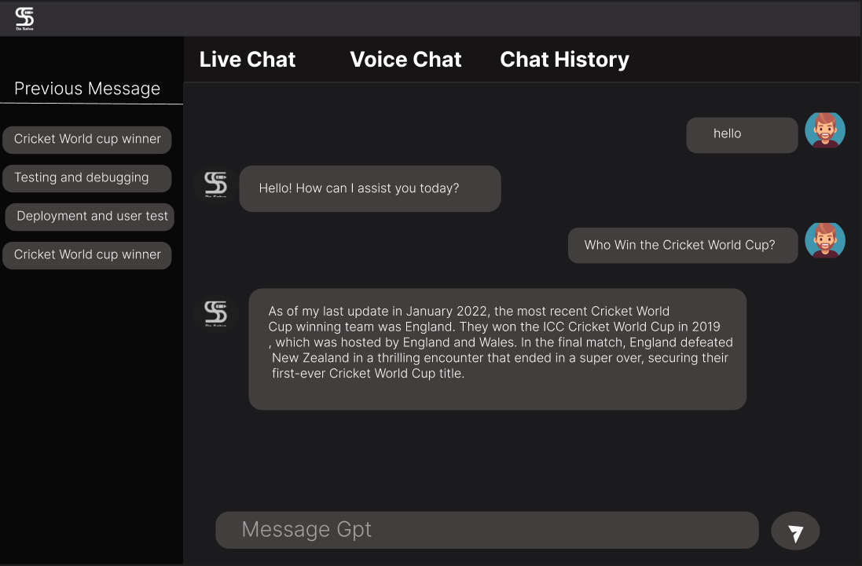
User Interaction

Slide 7
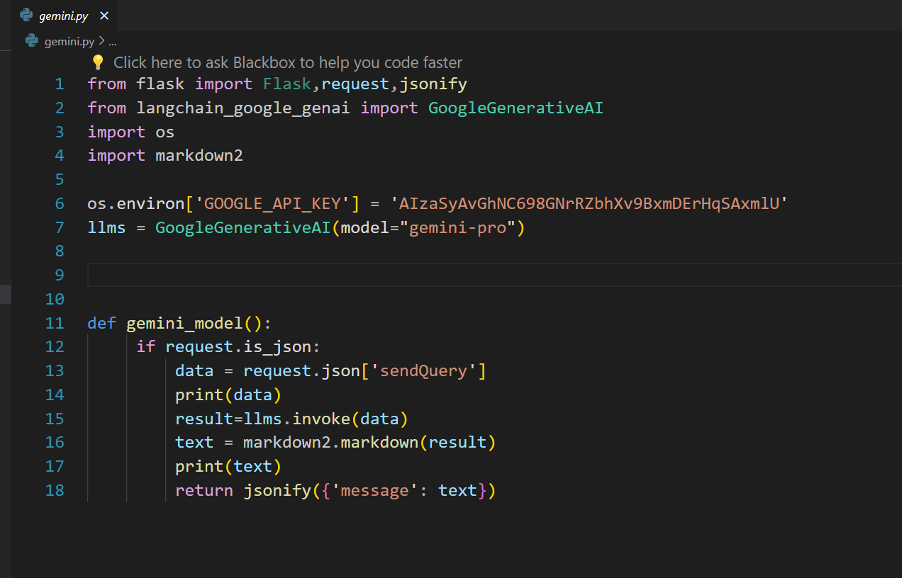
Gemini API Integration

Slide 8
Feature Scope
Current
Answer FAQs on a specific topic (Gemini API data)
Provide summaries of factual topics (from Gemini API)
Future
Implement authentication/authorization (security, access control)
Integrate with additional APIs for a wider range of information access.

Slide 9
Conclusion
My project has successfully developed a chatbot using the LangChain framework and integrated it with the Gemini API. It answers user queries on specific topics with Gemini data. Future plans include adding more APIs and implementing user security features. This project showcases the power of LangChain and Gemini API for building secure and informative chatbots.

Slide 10

Thank You
Presentation By – Supriyo Maity
Roll - 30001221043
Registration No : 213001001210043
Date: 10-05-2024

